Slide 1

Attiny HV and ISP Programmer
Developed at TAMI
Tel-Aviv Makers International

Slide 2
Project goals
Main goal
  High Voltage fuse reset of ATTami boards.
By products:
  High Voltage fuse reset of Attiny components.
  ISP programming of ATTami boards.
  ISP programming of Attiny components.
  ISP programming of various AVR based boards, under either 5V or 3.3V supply.
  Acceptance test of ATTami boards.
  Self contained ATTami bootloader loading (Not yet implemented)
ATTami HV and ISP Programmer
2/24/2015

Slide 3
Project structure
Arduino shield with the following features:
  Charge pump circuit to provide the 11.5V for the HV programming.
  Bi directional 5V to 3.3V level shifters.
  Sockets to enable programming of ATTami boards and Attiny components.
  Indicator LEDs.
  ATTami ATP LEDs.
  Control switches.
ATTami HV and ISP Programmer
2/24/2015

Slide 4
Charge pump circuit
Charge pump is a circuit that produces high voltage by switching of capacitors.
See: http://en.wikipedia.org/wiki/Charge_pump
In our case we produce 11.5V out of the Arduino 5V supply.
The 11.5V is controlled and regulated by the Arduino.
ATTami HV and ISP Programmer
2/24/2015

Slide 5
Bi directional 5V to 3.3V level shifters
4 MOSFET based bi-directional level shifters to shift the 5V Arduino I/O pins level to 3.3V.
See: http://delphys.net/d.holmes/hardware/levelshift.html
ATTami HV and ISP Programmer
2/24/2015

Slide 6
Sockets to enable programming of ATTami boards and Attiny components
  Pogo-Pins socket to enable programming and testing of pinless ATTami boards.
  Sockets to enable programming and testing of ATTami boards with upper or lower pins.
  Socket for 8 pin ATtiny programming.
  Socket for 14 pin ATtiny programming.
  Socket for 6 pin ISP ribbon.
  Socket for 10 pin ISP ribbon.
ATTami HV and ISP Programmer
2/24/2015

Slide 7
Control Switches
ISP – HV selector: Selects witch programming mode will be performed
3.3V – 5V selector: Selects the I/O pins level to conform with the external board connected to the ISP cables.
ISP Vcc – Target Vcc selector: Selects if The programmer will provide Vcc to the target board via the ISP cables.
ATTami test pushbutton: Provides Vcc to the ATTami board.
ATTami load bootloader: Initiate loading to the ATTami of the bootloader Hex file stored on the Arduino Flash memory. (This function is not yet implemented.)
ATTami HV and ISP Programmer
2/24/2015

Slide 8
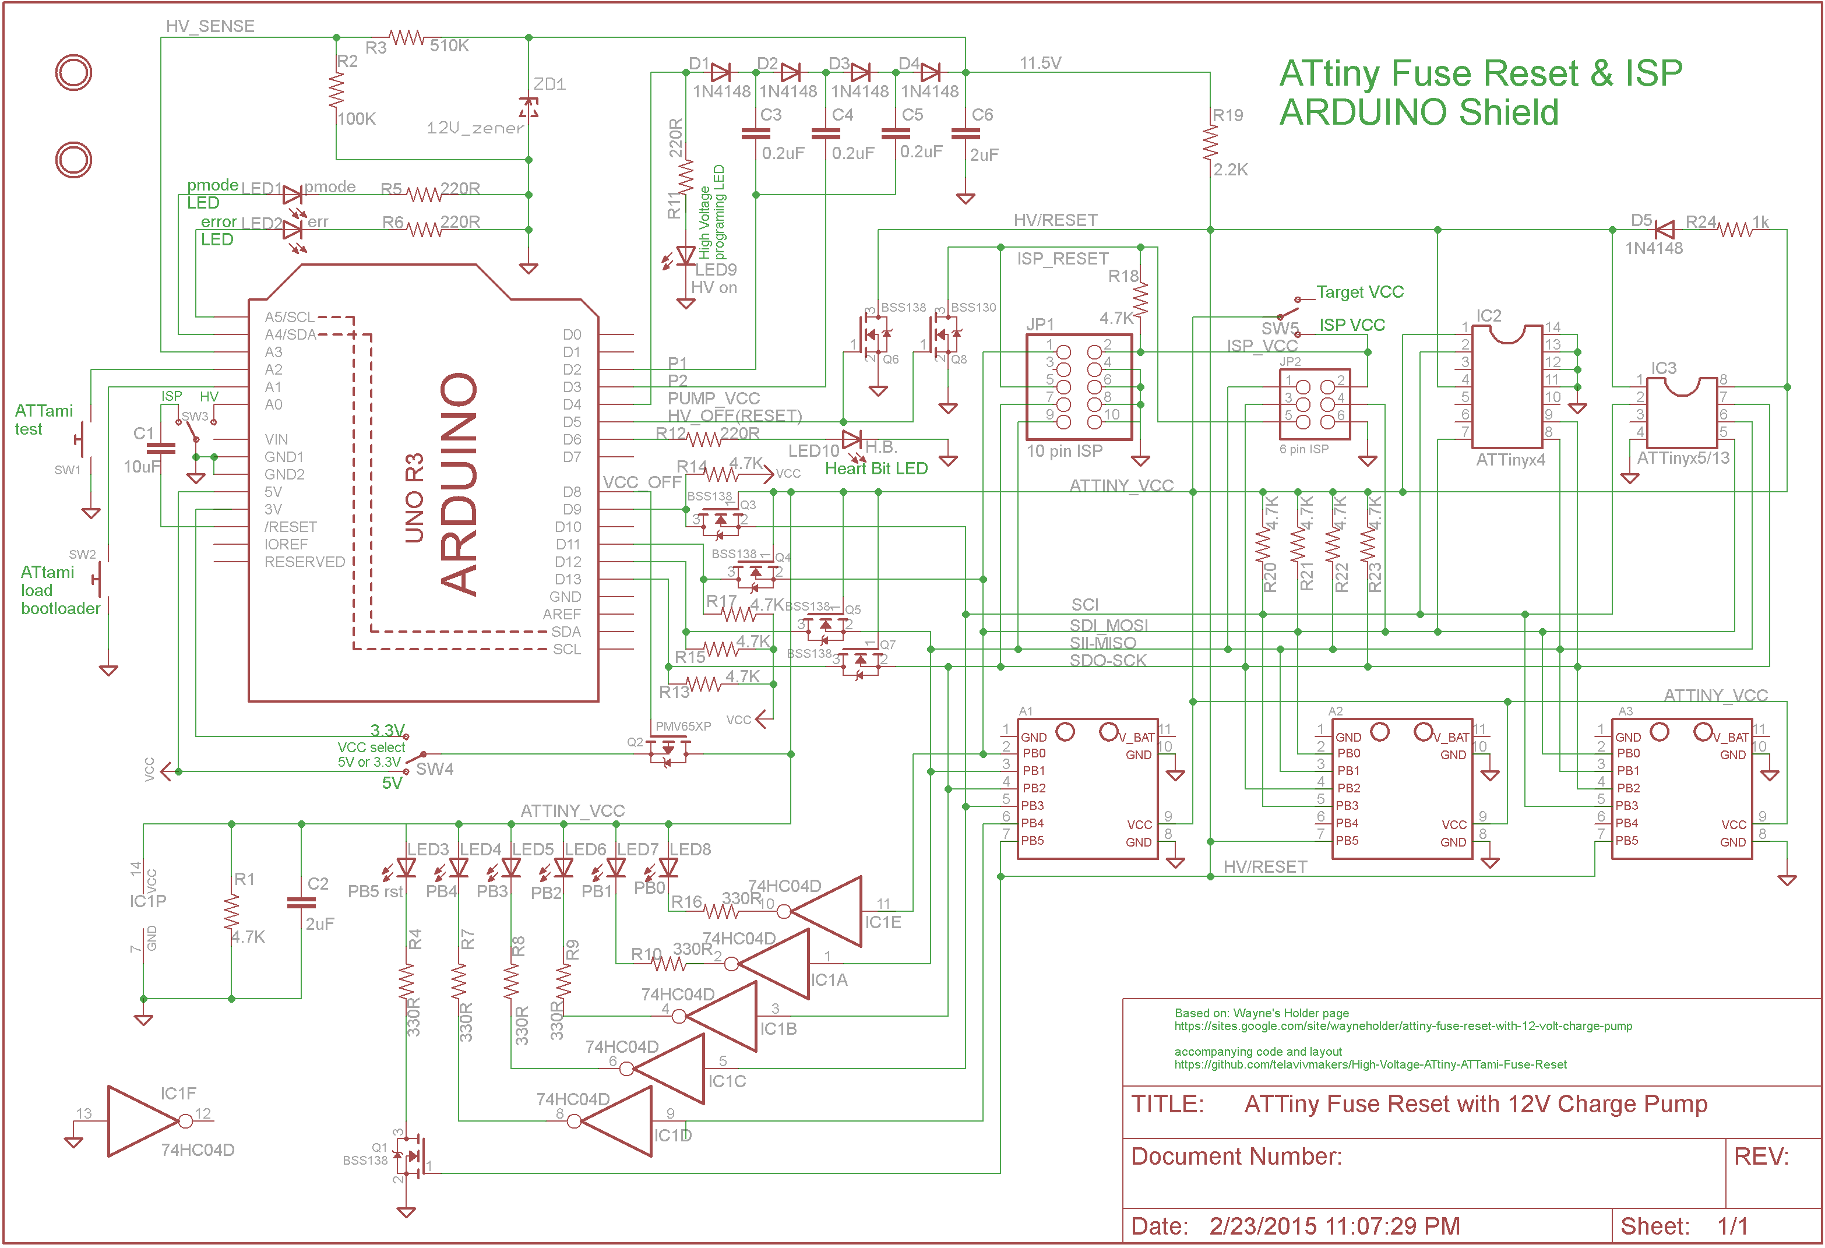
ATTami HV and ISP Programmer
2/24/2015

Slide 9
Operation
There are two modes of operation, each of them runs under different environment:
  HV fuse reset mode
  ISP mode
There are two control buttons. (The control buttons functionality is the same under both modes of operation)
  ATTami test button
  ATTAMI load bootloader button
ATTami HV and ISP Programmer
2/24/2015

Slide 10
Operation cont.
HV fuse reset mode
  In this mode you can:
    Reset the fuses to factory default state.
    Set the fuses to a predefined state.
    Define the predefined fuses state.
  To get into the mode:
    Connect the Arduino to the PC via a USB cable
    Set the ISP-HV selector to HV. (HB LED should on)
    Load Arduino IDE
    Open the Serial monitor (if necessary set it to 19200 baud rate)
  To reset the fuses
    Follow the instructions on the screen menu (While the HV is applied, in options 1 or 2, you should notice a short blink on the HV LED.)
ATTami HV and ISP Programmer
2/24/2015

Slide 11
Operation cont.
ISP programming mode
  In this mode you can:
    Upload a sketch into the ATtiny.
  To get into the mode:
    Connect the Arduino to the PC via a USB cable
    Set the ISP-HV selector to ISB. (HB LED should pulse)
    Load Arduino IDE
    Set the board according to your ATtiny MCU
    Set programmer to “Arduino as ISP
  To program the ATtiny
    Load your sketch into the IDE
    Click on the “Upload” button. (error LED might blink at start and then turn off, pmode LED should blink while Uploading is performed and then turned off.)
ATTami HV and ISP Programmer
2/24/2015

Slide 12
Operation cont.
ATTami test
  Operates on both HV and ISP modes.
  On Both modes when not actually programming the ATtiny VCC is off and the reset pin is LOW.
  When the test pushbutton is pressed Vcc is applied to the ATtiny and the reset pin goes HIGH. (The ATTami, or Attiny, will commence running)
  Watch the test LEDs for the ATP pattern.
ATTami HV and ISP Programmer
2/24/2015

Slide 13
Operation cont.
ATTami load bootloader
  Operates on both HV and ISP modes.
  Operates even when the Arduino is not connected to a computer (5V source is nedded)
  Momentary Push the “ATTami load bootloader” push buton.
  The Arduino will upload the boot loader Hex file to the ATTami.
This function is not yet implemented
ATTami HV and ISP Programmer
2/24/2015

Slide 14
Software build
The software comprises 3 ino files that are on the same directory
The directory name is “HV_ISP_programmer”
The 3 files are: “HV_ISP_programmer.ino”, “ATTinyFuseReset.ino” and “ArduinoISP_ATTami”.
“HV_ISP_programmer.ino” contains the setup() and loop functions(), “ATTinyFuseReset.ino” contains the HV programming functions, “ArduinoISP_ATTami” contains the ISP functions.
The IDE compile and build them together and Upload the produced Hex file to the Arduino. You should do it once before using the Programmer.
ATTami HV and ISP Programmer
2/24/2015

